Slide 1

IIMT COLLEGE OF ENGINEERING, Gr. NOIDA
Bachelor of Technology
Department of Information Technology
November, 2020
Mini Project
Submitted By:
Harshit Tyagi
1902160130021
B-Tech(IT)
3rd Sem. 2nd Year
Submitted To:
Mr. Vishwas Chandra
(Assistant Professor)
IT Department
IIMT Engg. College

Slide 2

Acknowledgement
I have taken efforts in this project. However, it would not have been possible without the kind support and help of many individuals and organizations. I would like to extend my sincere thanks to all of them.
I am highly indebted to Mr. Vishwas Chandra (Assistant Professor) for their guidance and constant supervision as well as for providing necessary information regarding the project & also for their support in completing the project.
I would like to express my gratitude towards my parents & member of IIMT College of Engineering Gr. Noida for their kind co-operation and encouragement which help me in completion of this project.
I would like to express my special gratitude and thanks to industry persons for giving me such attention and time.
My thanks and appreciations also go to my colleague in developing the project and people who have willingly helped me out with their abilities.

Slide 3


Calendar (Note Entry) & Tic Tac Toe Game
The Calendar and Tic Tac Toe game applications presented here are very simple console application developed in C programming language.
Both are built without using graphics properties; instead, both utilize many windows properties to give the application a colorful look and feel.
Both applications are combined in a single program and compiled in Code::Blocks using GCC compiler.

Slide 4

Calendar
A calendar is a system of organizing units of time for the purpose of reckoning time over extended periods. By convention, the day is the smallest calendrical unit of time; the measurement of fractions of a day is classified as timekeeping. The generality of this definition is due to the diversity of methods that have been used in creating calendars. Although some calendars replicate astronomical cycles according to fixed rules, others are based on abstract, perpetually repeating cycles of no astronomical significance.

Slide 5
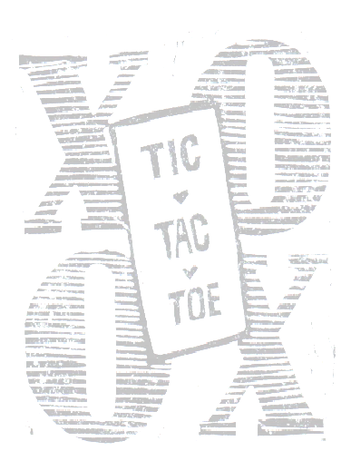
Tic Tac Toe
Tic-tac-toe, also called Noughts and Crosses (in the British Commonwealth countries), Xs and Os (in Ireland) and X and 0 (in India) is a pencil-and-paper game for two players, X and O, who take turns marking the spaces in a 3×3grid. The player who succeeds in placing three respective marks in a horizontal, vertical, or diagonal row wins the game. Hence, tic-tac-toe is most often played by young children.

Slide 6
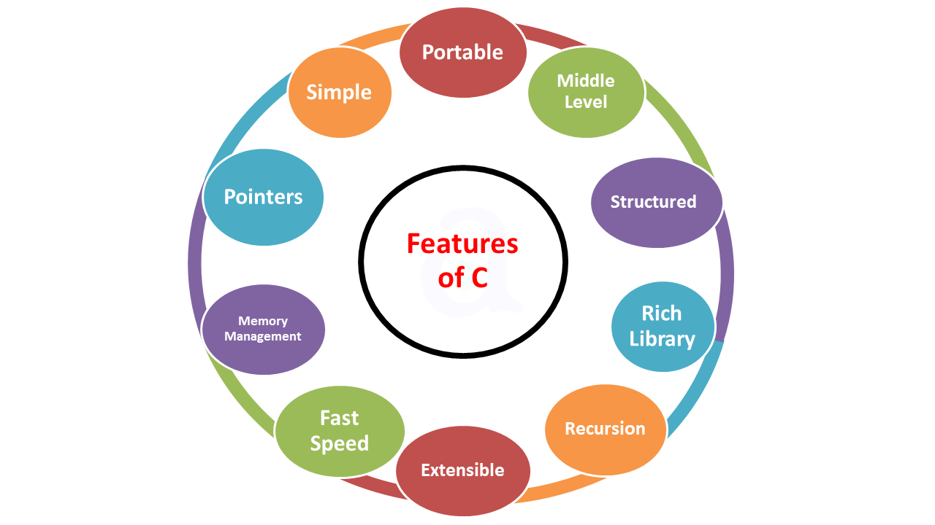
Technology Description
C is a general-purpose high level language that was originally developed by Dennis Ritchie for the UNIX operating system. It was first implemented on the Digital Equipment Corporation PDP-11 computer in 1972.
C-language has now become a widely used professional language for various reasons:
Easy to learn.
Structured language.
It produces efficient programs.
It can handle low-level activities.
It can be compiled on a variety of computers.

Slide 7

IDE Description
Why Code::Blocks?
Open Source! GPLv3, no hidden costs.
Cross-platform. Runs on Linux, Mac, Windows (uses wxWidgets).
Written in C++. No interpreted languages or proprietary libraries needed.
Extensible through plugins.

Slide 8

Implementation of Tic Tac Toe
Users are allowed to choose the number from 1 to 9 in the given layout to which he/she wants his symbol to be replaced.
System will read that number and compare it to the numbers which are already stored in the memory and replace the number to the symbol (either ‘X’ or ‘O) and then display the updated layout.
No symbol can be replaced twice because when the value was first update it also update the value of count variable and conditions are applied that symbols are replaced only at former value of count.
On entering value of the position to be replaced by the symbol a function matches the elements of three consecutive positions, if following positions matches then it declares the matched symbol as winner otherwise it continues to get the input for rest positions up to 9 positions.
Input can be entered maximum nine times.
If no three consecutive symbols matched then the game will be declared as Draw.

Slide 9
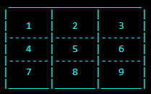
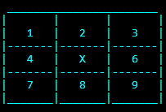
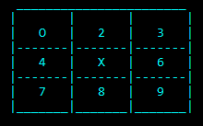
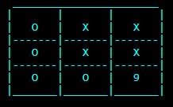
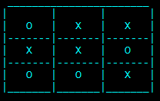
Tic Tac Toe Board
5 is Replaced by ‘X’
1 is Replaced by ‘0’
Program will continue to take inputs until the declaration of WINNER or DRAW.
When no three consecutive symbols matches,
Match will be declared as DRAW!!
First Vertical Column Matched
‘0’ will be declared as winner.

Slide 10
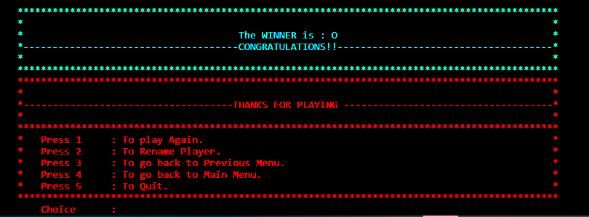

Slide 11

Implementation of Calendar
The most important thing to be kept in mind while printing yearly calendar is to get the number of first day of the year which we can get from the following algorithm:
d = (((y - 1) * 365) + ((y - 1) / 4) - ((y - 1) / 100) + ((y) / 400) + 1) % 7;
Second important thing is to check whether the entered year is a leap year or not if it is leap year then February contain 29 days otherwise 28days.
Leap year can be checked by the following algorithm
if ((y%4==0&&y%100!=0)||(y%400==0))
feb_days=29;
Thirdly we divide the days into weeks if no of days exceeds seven then new week started.
if(++weekday>7) {
printf("\n");
weekday=0;
}startingDay = weekday;
Any month of any year can be printed by applying the similar logics of viewing yearly calendar but not exactly same.
Notes can be added by using the concept of file handling and later in month view can be viewed.

Slide 12
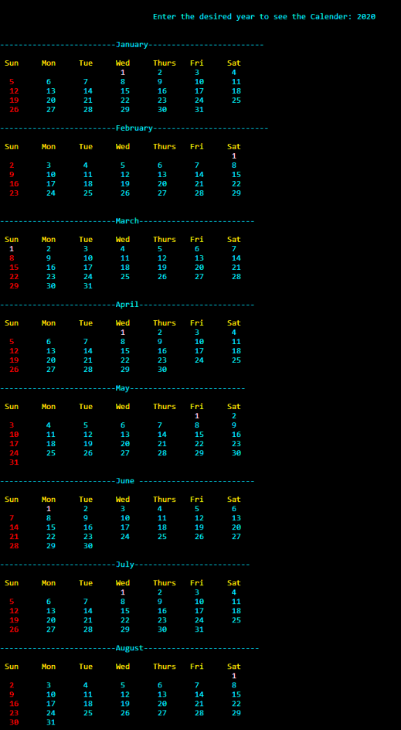
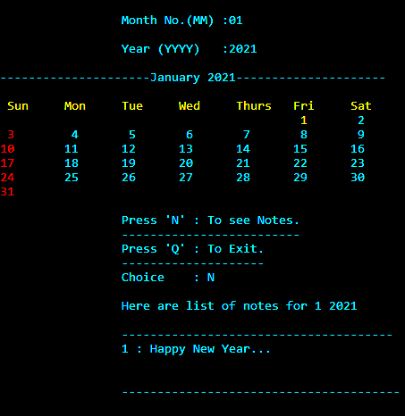
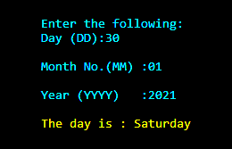
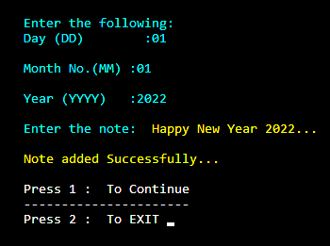

Slide 13

References
www.playgroundequipment.com
https://youtu.be/O8pwsby1Ock
www.ukessays.com
en.wikipedia.org
indiancybersecuritysolutions.com
eclipse.gsfc.nasa.gov
www.slideshare.net
www.geeksforgeeks.org
stackoverflow.com
www.lifehack.org

Slide 14




